Slide 1
Apple Trees
Structure

Slide 2
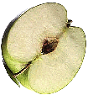
Apple Trees
All apple trees sold nowadays are made up from two quite separate parts, which together form the complete tree
Rootstocks
SCION

